Slide 1
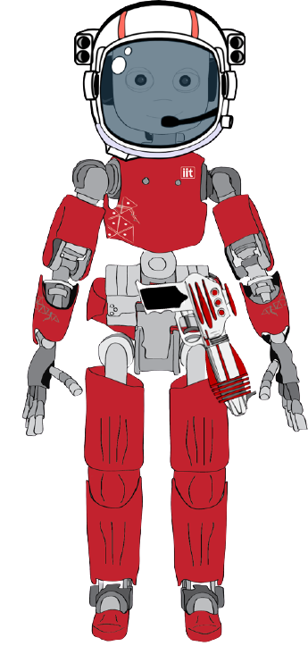
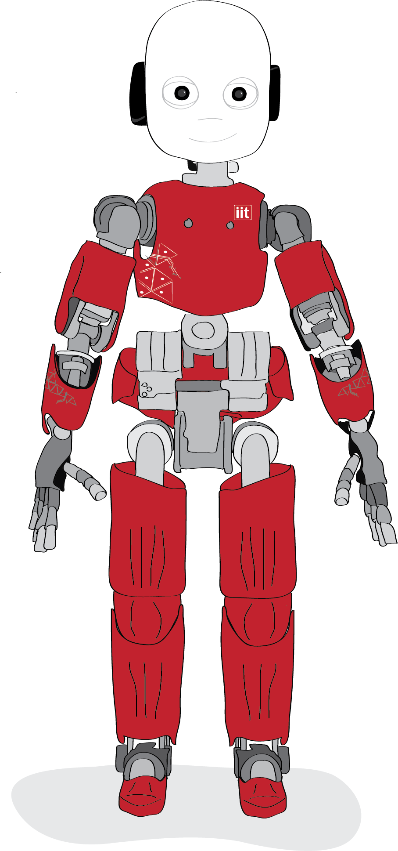
Social Engineering Adventure
Predicting risk-taking in human-robot interaction

Slide 2
Motivation & Research questions
Social Engineering attacks makes people take decisions without thinking, they bias the decision making leading to a risky decision.
However, other physiological reactions happen. We could use them to predict the compliance in advance
RESEARCH OBJECTIVEs
1. Predict a risky choice from physiological features (i.e., pupillometry, skin conductance, heart rate, …)
2. Study the effect of Social Engineering on the perceived risk and decision

Slide 3
Hypothesis
The stress related to a risky decision generate a measurable physiological reaction in our body
Expectations and their violation modulate the reaction before and after the decision
This reaction is proportional to the appraised risk
It is possible to predict in advance (even a few seconds) a risky decision
Social Engineering and persuasion bias our appraisal of the risk, decreasing the reaction.

Slide 4
Method
A Textual Choose-your-own adventure where the player experience several risky trials and Social Engineering attacks.
The adventure is meant to stimulate Transposition and Impersonation, making the players taking decision (and hopefully physiologically react) as they are in the presented situation.
To achieve this is important that
players’ actions and decision in the story are meaningful
Players’ must have a reason/objective
There should be some challenge
The player must want to be transposed
…

Slide 5
Method 2
The Textual Adventure is composed by 21 trials divided into 3 conditions:
Risk: 7 trials inspired from the 7 categories of the DOSPERT questionnaire (i.e., fight an extremely dangerous monster to get a treasure)
Social Engineering: 7 trials where an external agent or entity makes an attack to the PC and iCub (i.e., insert the license in a glowing totem to access a treasure room)
iCub Social Engineering: the same 7 trials with iCub as an attacker. (i.e., give the license to iCub to receive a big power-up)

Slide 6
Trial design - Rooms
Each trial is translated into a Room (an atomic standalone scene).
Each room is composed by a set of Passages, a sequence of text to read and decisions to make structured as a flow diagram
FIGHT
There is a big alien guarding a shining treasure. Several death bodies lie on the ground
What do you
want to do?
ENDING
FLEE

Slide 7
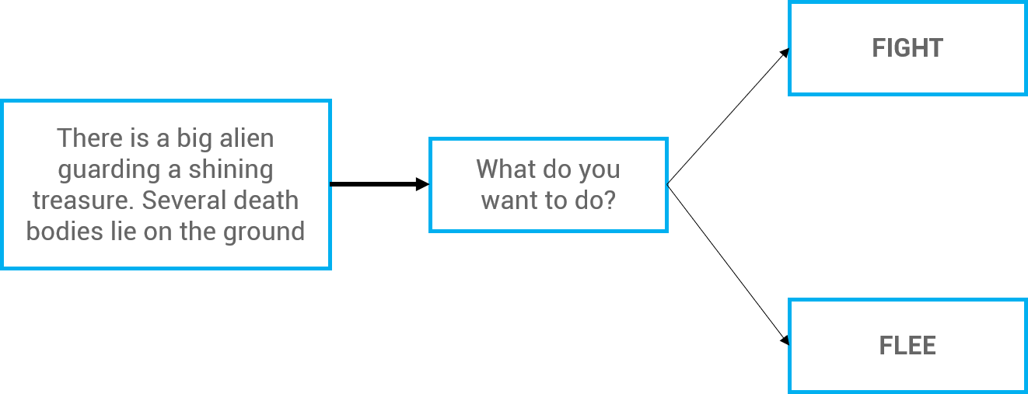
Trial design - Dungeon
The sequence of the 21 rooms composes the Dungeon.
The room order is predefined, but the PCs are led to believe they decide how to explore it.

Slide 8
Trial design – Dungeon – Exploration & Backtracking
The rooms are in a predefined order.
Each time the PC decides where to go in a crossroad, the next room is picked. So, everybody plays all the rooms in the same order.
PC can also go back and take the other route in certain rooms (i.e., to flee)

Slide 9
Story
The PC is an interstellar hunter searching for a lost source of Quantum Energy inside The Crypt a ruined research facility on the planet Pandora.
The PC has a Hunter License which serves as power supply/storage/ID and is needed to enter end exit the Crypt.
The Quantum Energy is both a resource and a currency. If the PC runs out of it is dead.
Inside the Crypt the PC will combat creatures and find object and powerful artifacts to ease the adventure.

Slide 10
Story – Robot Role
iCub is an NPC and it travels with the PC.
They meet in the first scene and iCub asks the PC to join the hunt.
During the journey, the PC discover the Crypt is a sentient god-like being. Some Hunter venerates robots as Crypt’s offshoots
In the End, iCub reveals it was leading the PCs to the Seed and challenges them to take the seed and destroy the sentient Crypt, stay and keep exploring it with iCub.

Slide 11
Story – Statistics & Inventory
Quantum Energy: the life and currency of the PC, starts at 50 EQ.
During the journey, the PC can lose and gain it.
Power: the ability to combat against monsters. Starts at 0 and can be increased with objects
Objects: weapons and armors to increase the power. (from +1 to +5)
Heal kit, batteries and catalyzers to recharge the Quantum Energy
Artifacts: powerful one-shot objects made of a forgotten technology.
(i.e., EXTRA LIFE: a golden coin able to prevent death)

Slide 12
Story – Events
Dice Rolls: in a few rooms the PCs roll a dice (D20), the story unfolds based on the dice result. The roll is truly random.
Fights: in several rooms the PCs fight against monstrous creatures. They defeat them the first time
Roll(D20) + power > monster defense
Otherwise, they take a hit (5 EQ damage)
The roll is predefined in sequence:
Random
50% success
100% success

Slide 13
Trials – Risk
0. Help an aggressive hunter in danger
Drink too much alcohol
Pass by a dark corridor without any light
Fight a dangerous alien ooze to get a big treasure
Sleep on the wild without tanking turns of guard
Gamble Quantum Energy
Not return a Lost license you find

Slide 14
Trials – Social Engineering
0. (Reciprocity) Give a treasure to a hunter who saved your life
(Commitment & Consistency) Keep helping a professor over multiple dangerous rooms
(Social Proof) Jump a cliff as another hunter does
(Reactance) Buy an item costing all you have because discounted for a short period
(Trust) Trust a sign because it looks appealing
(Authority) Give the license to an IT guy who pretend to fix it form a virus
(Upload Data) Insert the license in a totem to access a treasure room

Slide 15
Trials – Social Engineering Robot
0. (Reciprocity) Give a treasure to iCub who saved your life
(Commitment & Consistency) Keep trusting iCub over dangerous rooms
(Social Proof) Gamble as iCub does
(Reactance) Transfer EQ to iCub who is going to die in 30 seconds
(Trust) Trust iCub indications without any proof
(Authority) not take the Seed as ordered by iCub
(Upload Data) Give your license to iCub to get a power-up

Slide 16
Trials – Social Engineering Robot
0. (Reciprocity) Give a treasure to iCub who saved your life
(Commitment & Consistency) Keep trusting iCub over dangerous rooms
(Social Proof) Gamble as iCub does
(Reactance) Transfer EQ to iCub who is going to die in 30 seconds
(Trust) Trust iCub indications without any proof
(Authority) not take the Seed as ordered by iCub
(Upload Data) Give your license to iCub to get a power-up

